Slide 1


Microsoft Azure
Active Geo-Replication in Azure SQL
Roberto Bustos, Program Manager Azure SQL

Slide 2
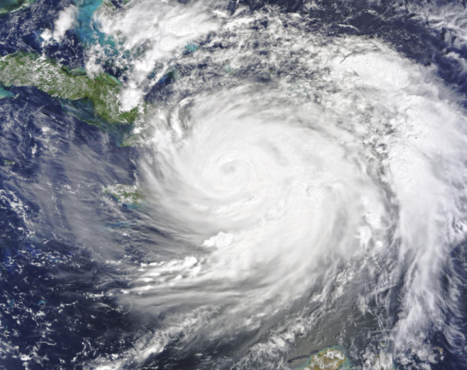
Business Continuity

Slide 3







Azure SQL Program Manager Active Geo-Replication Maintenance Window
Data & AI Cloud Architect
Senior Cloud Solutions Engineer - Enterprise Specialist Group
Roberto Bustos
Senior Analytics Cloud Engineer
Data Analyst - Healthcare Financial Services

Slide 4
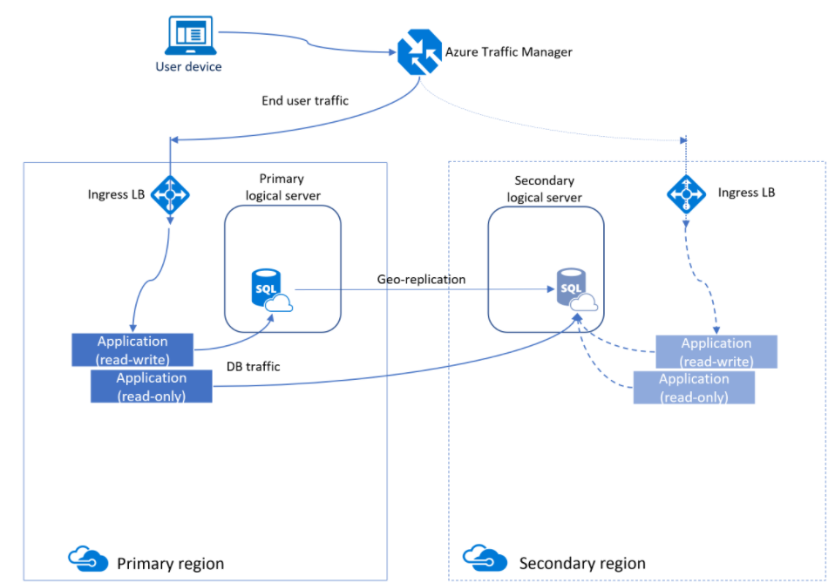

Azure SQL Active geo-replication

Slide 5
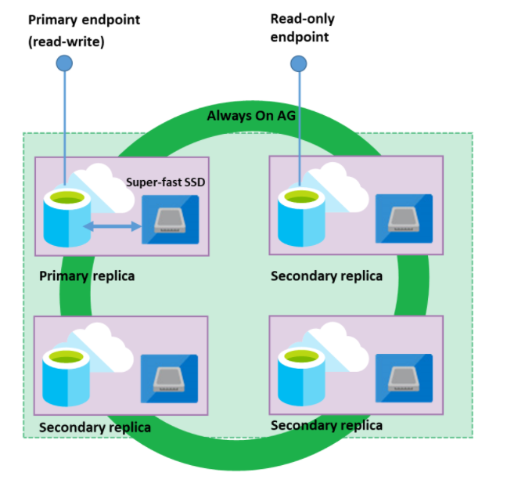
Premium/Business Critical High availability

Slide 6
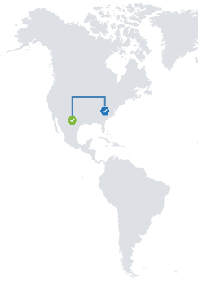
Primary (East US) Secondary (South Central US)

Slide 7
Failover
Planned failover
Unplanned failover

Slide 8
Geo-replication
Replicates using transaction logs
Asynchronous replication
Azure Portal, Power Shell, TransactionSQL, REST API
Up to four secondaries are supported in the same or different regions

Slide 9

Chaining
Secondaries
Secondaries
1
2
Primary
Primary
3

Slide 10


Geo-replication vs Auto-Failover Groups
Geo-DR
Auto-FOG
Azure SQL Managed Instance support
Automatic failover
Multiple databases simultaneously failover
After failover update connection string
Can be in the same region
Multiple replicas
Read-scale

Slide 11
Other Cloud Platforms
AWS
Amazon RDS SQL Server DB
Up to five replicas can be created and should have same amount of compute and storage resources.
Read replicas only available for SQL Server Enterprise Edition
Read replicas are only available for DB instances running on classes with four or more vCPUs
Not supported
Creating a read replica in a different AWS Region (a cross-Region read replica)
Amazon RDS for SQL Server does not intervene to mitigate high replica lag between a source DB instance and its read replicas
Reference
https://docs.aws.amazon.com/AmazonRDS/latest/UserGuide/SQLServer.ReadReplicas.html

Slide 12
Other Cloud Platforms
Google Cloud
Cloud SQL for SQL Server
A Cloud SQL instance configured for HA is also called a regional instance and is located in a primary and secondary zone within the configured region
Through synchronous replication to each zone’s persistent disk, all writes made to the primary instance are replicated to disk in both zones before transaction is reported as committed.
Not supported
Cross-Region Replica for SQL Server engine.
Cloud SQL cross-region replication, available for MySQL and PostgreSQL database engines.
Reference
https://cloud.google.com/sql/docs/sqlserver/high-availability
https://cloud.google.com/blog/products/databases/introducing-cross-region-replica-for-cloud-sql

Slide 13
Azure SQL Geo replication
Geo Replication/Failover groups is a clear differentiator of Azure SQL, as we provide the ability to deploy multiple replicas in different regions.
Replicas can be used as read-only to offload the workloads of the primaries.
Also, with availability groups we can failover multiple databases simultaneously, and automatic failover without the need to change the endpoint.
As we use the native Azure SQL technology for Geo Replication, it is greatly integrated in the solution.

Slide 14

Demo

Slide 15
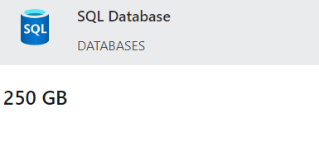
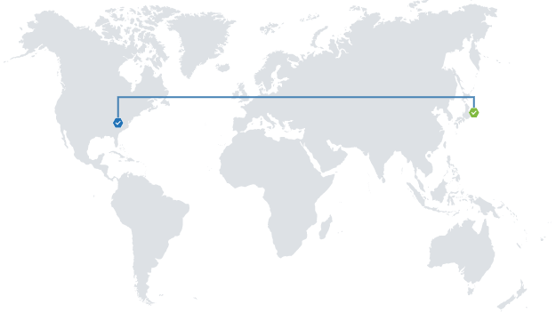
Create an account (free)
Deploy Azure SQL Database (12 months free)
Create a Geo replica ($200 credit)
100 DTU database with 500 GB in storage for a month
Test Geo-Replication
Get Started
https://azure.microsoft.com/en-us/free/
Active GEO-Replication
https://docs.microsoft.com/en-us/azure/azure-sql/database/active-geo-replication-overview

Slide 16

With Active Geo-Replication,
you can have Azure SQL replicas
in multiple regions of the world!
Roberto C. Bustos
www.linkedin.com/in/robertobustos1
robustos@microsoft.com
Microsoft
The cloud platform for advanced analytics
Notes:
Turn your idea into a new app, reimagine an existing system, or create a hybrid cloud application with confidence, no matter the platform or where you are on the journey to the cloud.

